Slide 1

NutriSnap
A FOOD DETECTION AND NUTRITION FACTS GENERATION MOBILE APPLICATION
PRESENTED BY RAYMOND TAN 2104090
SUPERVISED BY TS LAI SIEW CHENG

Slide 2
TABLE OF CONTENTS
5_Features & Workflows
6_Implementation
7_Evaluation and Challenges
8_Conclusion
1_Introduction
2_Literature Review
3_Methodology
4_System architecture

Slide 3

INTRODUCTION | Problem Statement
Existing health apps still rely on manual food logging → time-consuming, error-prone
Most current solutions require manual input, leading to errors in portion estimation and inaccurate tracking.
Solution: NutriSnap integrates computer vision + nutrition databases for automated recognition

Slide 4
INTRODUCTION | Motivation
Rising prevalence of diet-related health issues (obesity, diabetes, malnutrition).
Mobile devices = accessible tool for dietary management.
Providing real-time nutritional feedback encourages healthier eating.
Goal: reduce effort + increase accuracy in food logging for daily use.

Slide 5
INTRODUCTION | Objectives
Design a mobile-based food recognition system (YOLOv8s + MobileNetV3 + Nutrition API)
Implement with Flutter, including auth, recognition, nutrition, history, analysis
Evaluate system performance (accuracy, reliability, usability)

Slide 6
INTRODUCTION | Scope
Covers:
Food recognition from images.
Nutrition facts retrieval via CalorieNinjas API.
History tracking + analysis stored in Firebase.
Limitations:
No portion estimation.
No personalized diet recommendations.
Project direction: lightweight, efficient models → real-time inference on mobile.

Slide 7
INTRODUCTION | Contributions
Developed a functional mobile application (NutriSnap).
Integrated CalorieNinjas API for up-to-date nutrition data.
Built two-stage pipeline: YOLOv8s (detect) + MobileNetV3-Large (classify).
Added Nutrition Analysis module: daily, weekly, monthly summaries.
Encourages healthier eating habits through automation + awareness.

Slide 8

Literature Review

Slide 9
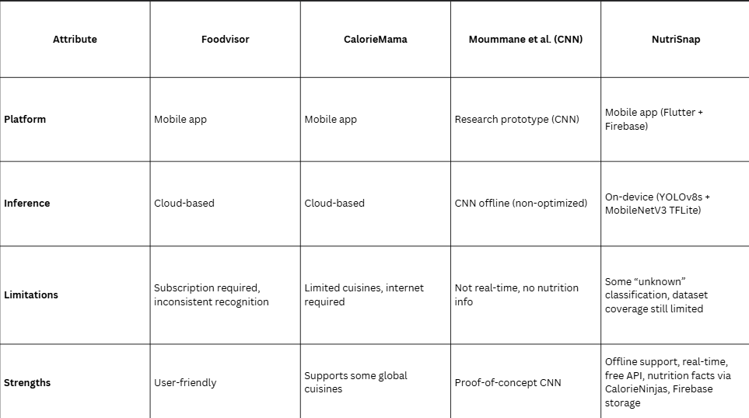
Comparison of Existing System and Proposed Sytstem

Slide 10

Methodology

Slide 11
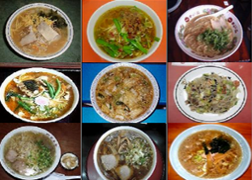
Dataset _ UECFood256
Overview
Total Images : 31395 food images
Categories : 256 different food classes
Annotation : Each image includes bouding box for food region
Val_Ratio used : 0.2
Why UECFood256?
✅ Large and diverse dataset → covers many common dishes.
✅ Provides bounding boxes → perfect for training detection models (YOLO).
✅ Widely used in research → allows benchmarking against prior works.
⚠️ Limitation: Mostly Japanese/Asian dishes, not all Malaysian/local foods.

Slide 12
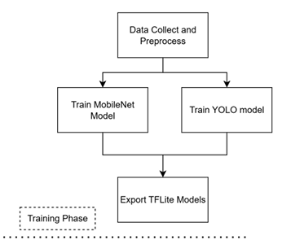
Training Phase
Data collection & preprocessing → curated dataset.
YOLOv8s training:
Task = detect “food” regions.
Output = bounding boxes, cropped images
MobileNetV3-Large training:
Input = cropped food regions.
Output = food class label.
Converted both models → TensorFlow Lite (TFLite) for mobile deployment.

Slide 13
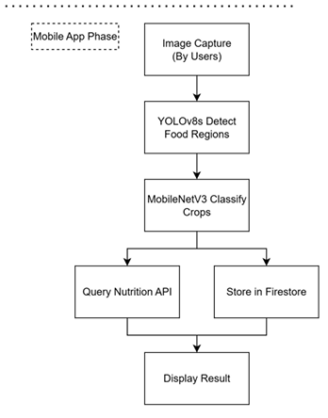
Application Phase
Workflow:
User captures/selects food image.
YOLOv8s detects food → bounding boxes.
Cropped food passed to MobileNetV3 → classification.
Classified labels sent to CalorieNinjas API.
Nutrition results displayed in Result Screen.
Data stored in Firebase Firestore.
Users can view history + nutrition analysis later.
Design approach: modular, scalable, real-time.

Slide 14
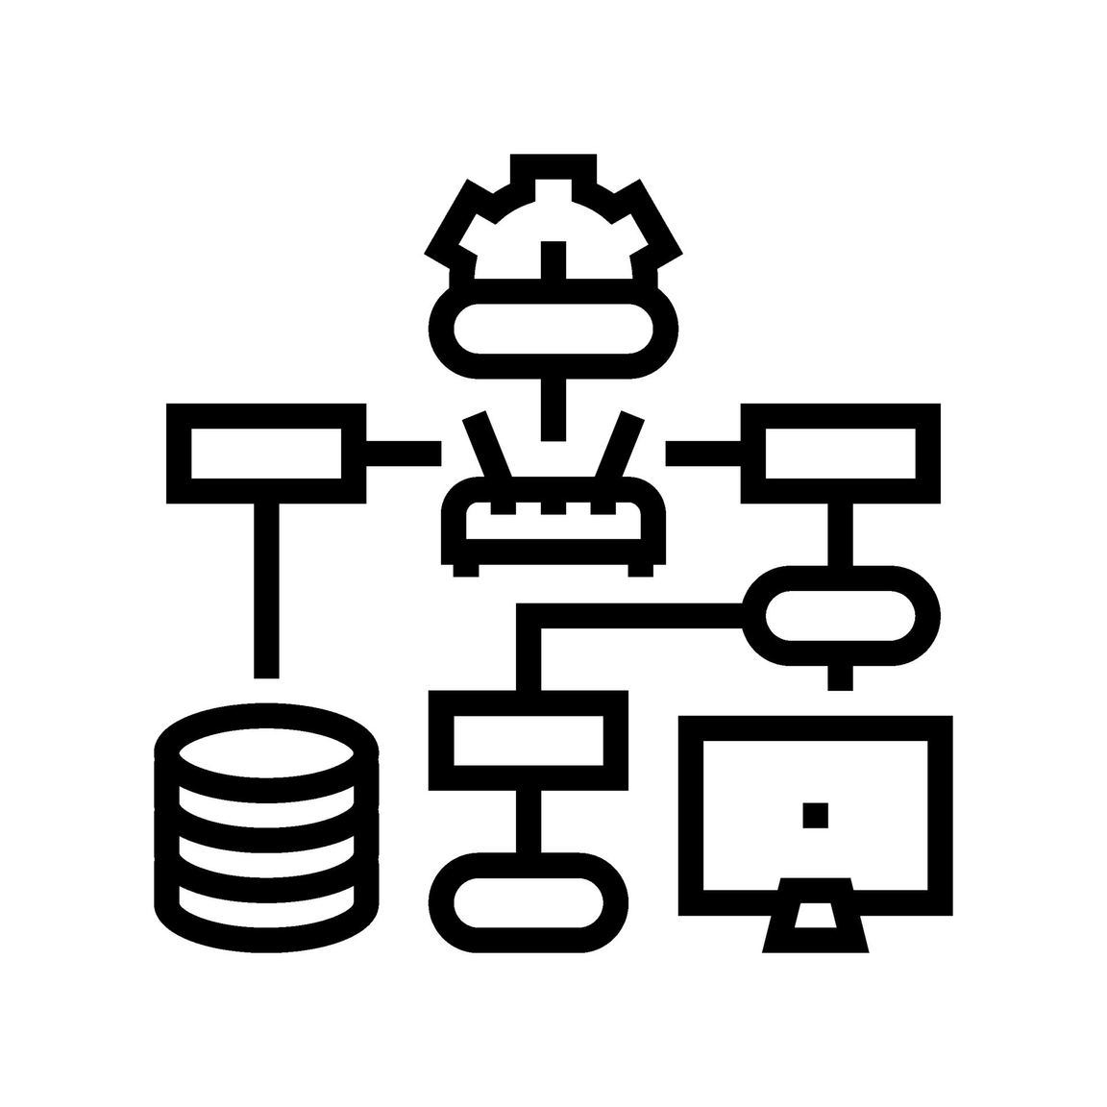
System Architecture

Slide 15
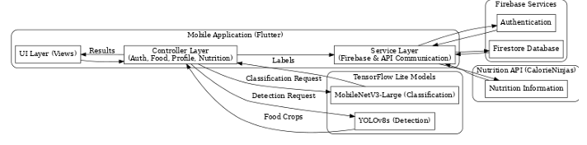
System Architecture Diagram

Slide 16
System Architecture Diagram
UI Layer (Views): All screens users interact with (Login, Home, Result, History, Profile, Nutrition Analysis).
Controller Layer (GetX): Connects UI ↔ logic. Each controller has a role:
AuthController → login/logout, session handling.
FoodController → processes camera/gallery image, runs YOLO & MobileNet.
ProfileController → user details (age, weight, height) synced with Firestore.
NutritionController → takes classification result, queries CalorieNinjas API, saves history.
Service Layer: Communicates with Firebase Auth, Firestore DB, and CalorieNinjas API.

Slide 17
System Architecture Diagram
YOLOv8s (Detection): Finds “food” regions → bounding boxes. Lightweight, high recall.
MobileNetV3-Large (Classification): Classifies cropped regions into food categories (e.g., nasi lemak, banana). Optimized for mobile.
Why two-stage? → YOLO detects multiple foods in a single picture; MobileNet ensures accurate labeling.

Slide 18
System Architecture Diagram
Firebase Cloud Services
Authentication: Secure login (Email/Google).
Firestore Database: Stores user profiles + recognition history (food label, nutrition facts, timestamp).
2. Nutrition API (CalorieNinjas)
Input: predicted food labels (e.g., “banana”).
Output: nutrition facts (calories, protein, carbs, fats).
Benefit: keeps database updated without storing everything locally.

Slide 19


Features
What the application do?
Features & Workflow
Workflow
How the application do?

Slide 20



Features
Authentication
History Tracking
Food Recognition
Firebase Email/Password and Google Sign-In.
Handles signup, login, logout, session persistence.
Ensures secure access for each user.
Each recognition result is saved in Firestore with:
Food name, nutrition data, timestamp.
Users can revisit past recognitions in History Screen.
Two-stage pipeline:
YOLOv8s → detect food regions.
MobileNetV3-Large → classify cropped regions.
Real-time inference using TensorFlow Lite.

Slide 21

Features
Nutrition Facts Retrieval
Nutrition Analysis
Profile Management
Uses CalorieNinjas API.
Returns calories, protein, carbs, fats for each recognized food.
Keeps nutrition data up-to-date without large local DB.
Aggregates history data into daily, weekly, monthly summaries.
Shows macronutrient breakdown + calorie intake trend.
Provides simple feedback (e.g., “low protein”, “over calorie target”).
Stores personal details (age, weight, height).
Allows users to update their profile.
Data syncs with Firestore in real time.

Slide 22
Authentication Workflow
App starts → SplashScreen checks login status.
If not logged in → LoginScreen.
AuthController manages login via Firebase.
After successful login → HomeScreen.
Logout → session cleared, return to LoginScreen.
1
Workflows
Food Recognition Workflow
User captures/selects an image from camera/gallery.
FoodController sends image to YOLOv8s → detect food regions.
Cropped regions sent to MobileNetV3 → classify into food labels.
NutritionController queries CalorieNinjas API → retrieve nutrition data.
Results shown in ResultScreen.
2

Slide 23
History Workflow
NutritionController saves recognition results in Firestore:
{ foodName, calories, protein, carbs, fats, timestamp }
HistoryScreen fetches and displays records in chronological order.
Supports continuous dietary monitoring.
3
Workflows
Profile Workflow
ProfileController manages user details (age, weight, height).
Any updates made in ProfileScreen → synced instantly to Firestore.
AuthController integrated for logout function.
4

Slide 24
Nutrition Analysis Workflow
When user opens NutritionAnalysisScreen:
NutritionController fetches recognition history from Firestore.
Aggregates nutrient totals (calories, protein, carbs, fats).
Generates summaries: daily, weekly, monthly.
Provides recommendations (e.g., highlight low protein, excess carbs).
Helps user reflect on long-term eating habits.
Workflows
5

Slide 25
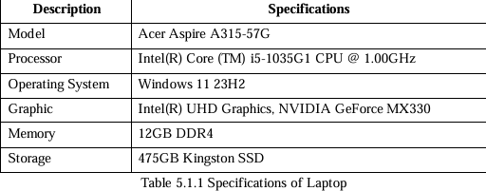
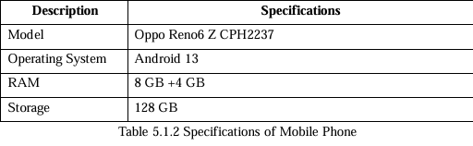
Implementation_ Hardware Setup
→ Model training, Flutter coding, Firebase setup
→ Testing camera, Food recognition, Firebase sync

Slide 26
Implementation_ Software Setup
Development Tools:
Flutter SDK 3.29.3 + Dart SDK 3.7.2
Visual Studio Code (coding)
ML Models:
YOLOv8s (detection) → trained, converted to TFLite.
MobileNetV3-Large (classification) → trained, converted to TFLite.
Integrated with tflite_flutter package.
Firebase Services:
Authentication (email/password, Google Sign-In).
Firestore DB (user profile + recognition history).
Firebase Storage (optional for storing images).
Nutrition API:
CalorieNinjas REST API → returns nutrition facts (calories, protein, carbs, fats).

Slide 27
Implementation_ Key Dependencies & Configuration
Core: flutter, get, intl
Machine Learning: tflite_flutter
Firebase: firebase_core, firebase_auth, cloud_firestore, firebase_storage, google_sign_in
Image Handling: image_picker, image
Networking: http, cached_network_image
UI Enhancements: flutter_spinkit
Firebase Setup:
Added google-services.json to Android app.
Firestore DB → users collection + history sub-collection.
Security rules → fixed permission errors during development.
Model Integration:
Models + labels stored in /assets.
Declared in pubspec.yaml.
Loaded at runtime with tflite_flutter.
App Permissions (AndroidManifest.xml):
CAMERA → take pictures.
READ_MEDIA_IMAGES (Android 13+).
READ_EXTERNAL_STORAGE (older versions).

Slide 28

System Demo

Slide 29
Male
Formulas of Goal Calculation
BMR=
10×Weight(kg)+6.25×Height(cm)−5×Age(years)+5
Female:
BMR=
10×Weight(kg)+6.25×Height(cm)−5×Age(years)−161
Maintenance Calories (kcal/day)
Calories= BMR ×1.2
Protein (grams):
Carbs(grams):
Fat (grams):
Protein=(Calories×0.15​)/4
Carbs
=(Calories×0.55​)/4
Fat=
(Calories×0.30​)/9

Slide 30
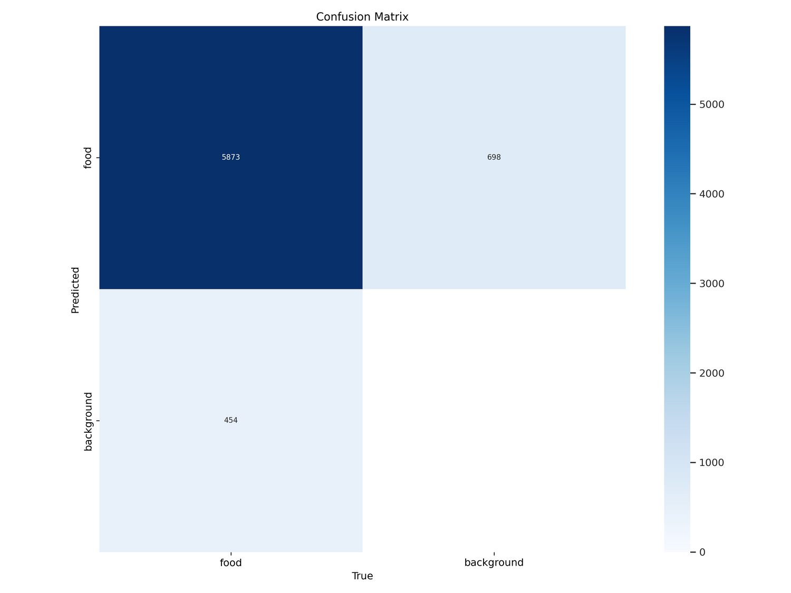
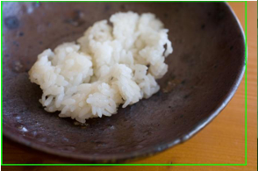
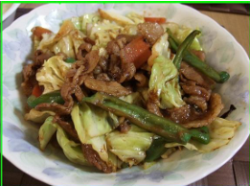
EVALUATION & CHALLENGES
YOLOv8s Detection
Food vs Background)
Precision : 73.4%
True Positives: 5873
False Negatives: 454
False Positives: 698
High recall (93.8%)(most food detected), but cluttered backgrounds sometimes misdetected as food.

Slide 31
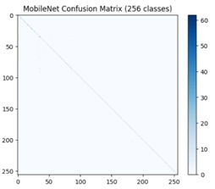
EVALUATION & CHALLENGES
MobileNetV3-Large Classification (256 classes)
Confusion matrix showed strong diagonal dominance (good accuracy => 63.0%).
Accurate on common foods.
Misclassifications mainly in visually similar categories (e.g., fried vs grilled chicken).
Underrepresented classes caused some errors.

Slide 32
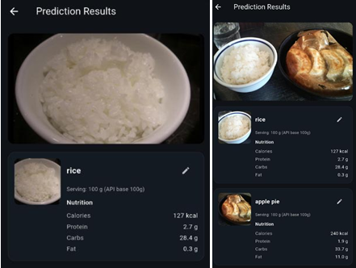
EVALUATION & CHALLENGES
Combined Pipeline
(YOLO + MobileNet + API)
Successfully recognized multiple foods in a single image.
Correctly retrieved nutrition info from CalorieNinjas API.
Saved results in Firestore for later history/analysis.

Slide 33
EVALUATION & CHALLENGES
Model-Related
False positives in YOLO detection (background items misdetected as food).
Unknown predictions in MobileNet for foods not in dataset.
Visually similar foods misclassified (e.g., fried chicken vs baked salmon)
Dataset didn’t cover all local Malaysian mixed dishes → reduced real-world accuracy.
System Integration
Firestore Permission Errors: caused “insufficient permissions” after logout → fixed by adjusting security rules.
Profile Sync Issues: nickname not persisting across sessions → solved with immediate Firestore update.
History Refresh: user had to refresh manually to see new entries → fixed with snapshot listeners.

Slide 34

CONCLUSION AND RECOMMENDATIONS

Slide 35
CONCLUSION
Project Goal Achieved
System Architecture
Implementation
Built NutriSnap, a mobile app that integrates food recognition + nutrition estimation.
Real-time, lightweight, and user-friendly prototype.
Modular 3-layer design: UI, Controllers, Backend.
Clear separation of concerns → easier debugging & scalability.
Flutter + Dart for cross-platform app.
YOLOv8s (detection) + MobileNetV3-Large (classification) in TFLite.
Firebase (Auth + Firestore) + CalorieNinjas API.
Limitations
Evaluation Results
YOLO false positives in cluttered backgrounds.
MobileNet misclassified visually similar foods.
Dataset coverage limited for Malaysian mixed dishes.
Some deployment issues (Firebase sync, Android permissions, API limits).
YOLOv8s → high recall, robust detection.
MobileNetV3 → strong accuracy for common foods.
All major modules (auth, recognition, history, profile, analysis) tested successfully.

Slide 36
1
2
Model Enhancement
Data Augmentation & Expansion
Retrain with larger + diverse datasets (local Malaysian dishes, mixed platters).
Explore alternative architectures like EfficientNet, Vision Transformers (ViT).
Use techniques like rotation, color jitter, synthetic images.
Crowdsourcing/collaboration for a larger, culturally relevant dataset.
RECOM
MEN-
DATIONS
3
4
User Experience Improvements
Advanced Features
Portion size estimation using AR / depth sensors.
Integration with wearables (smartwatch, health tracker).
Hybrid input: combine image + text description for improved accuracy.
Add notifications/reminders to improve user engagement.
Multilingual support

Slide 37

"Thank you for your patience.”

